Slide 1
Example script for using data files in Matlab
Import entire program source code to your Matlab path. Run fileReadSample.m from main program directory.
The script prompts for a file name and stores the data on your workspace
The measurement data is organized in an array of structures:
LoopNr = 1; % number of loop
X1 = Loops(LoopNr).field; % Measured field [Oe]
X2 = Loops(LoopNr).field_setpoint; % field setpoint [Oe
Y1 = Loops(LoopNr).signal; % pickup signal [V]
Y2 = Loops(LoopNr).signal_quadr; % quadrature of pickup signal [V]
D_f = Loops(LoopNr).field_stdev; % standard deviation of field
D_s = Loops(LoopNr).signal_stdev; % standard deviation of signal
T1 = Loops(LoopNr).temperature; % temperature (TempController)
Y3 = Loops(LoopNr).customval; % custom value (CustomController)
Y4 = Loops(LoopNr).customval_adc; % custom channel of ADC-Card
M = Loops(LoopNr).datapoints; % all data as Matrix
Be careful: MF.saveMagnetizationCurve(…) would overwrite your data file without prompting

Slide 2
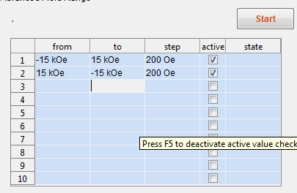
Hotkeys
Hotkeys inside Sweep Tables:
Key | Function
CTRL + X | Clear entire Table
CTRL + C | Copy entire sweep sequence
CTRL + Y | Copy and use comma as decimal seperator. (German MS Excel compatible)
CTRL + V | Paste sweep table
F5 | Deactivate interactive scientific units and range checking (0.5 -> 500mOe)
F6 | Add new row above
F7 | Delete current row
CTRL + F11 | Try to resize (may fail)

Slide 3
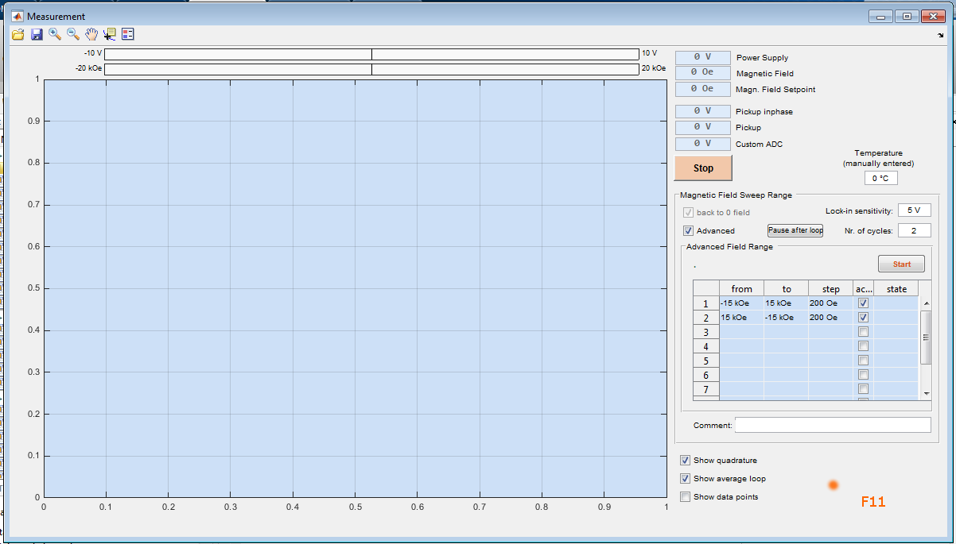
Hotkeys
The Plot window automatically resizes on screens with a lower resolution.
If components get hidden the window frame can get resized by mouse
Clicking an a free area of the window an pressing F11 forces all components to resize keeping correct aspect ratio
Does not work with multiple screens

